Slide 1
Online Shopping By Harsh Modi Chandana Sheetanshu Sandeep lanka

Slide 2
Easy Shopping
Easy Shopping is an E-Commerce web application.
Application provides platform for users to buy products and retailers to sell their products through online.
The application UI is very simple and efficient.
This application has 3 users
User
Retailer
Admin

Slide 3
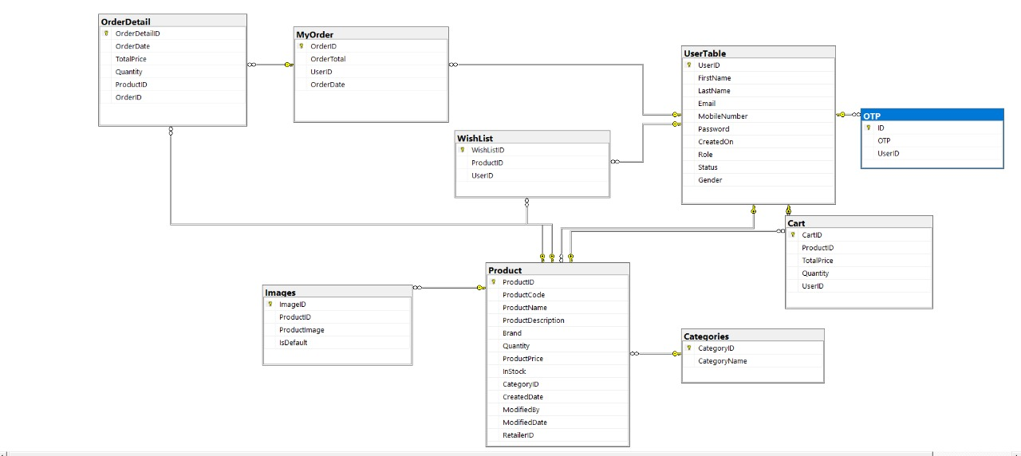
Database Design
Application will implement all the CRUD operations on data base

Slide 4
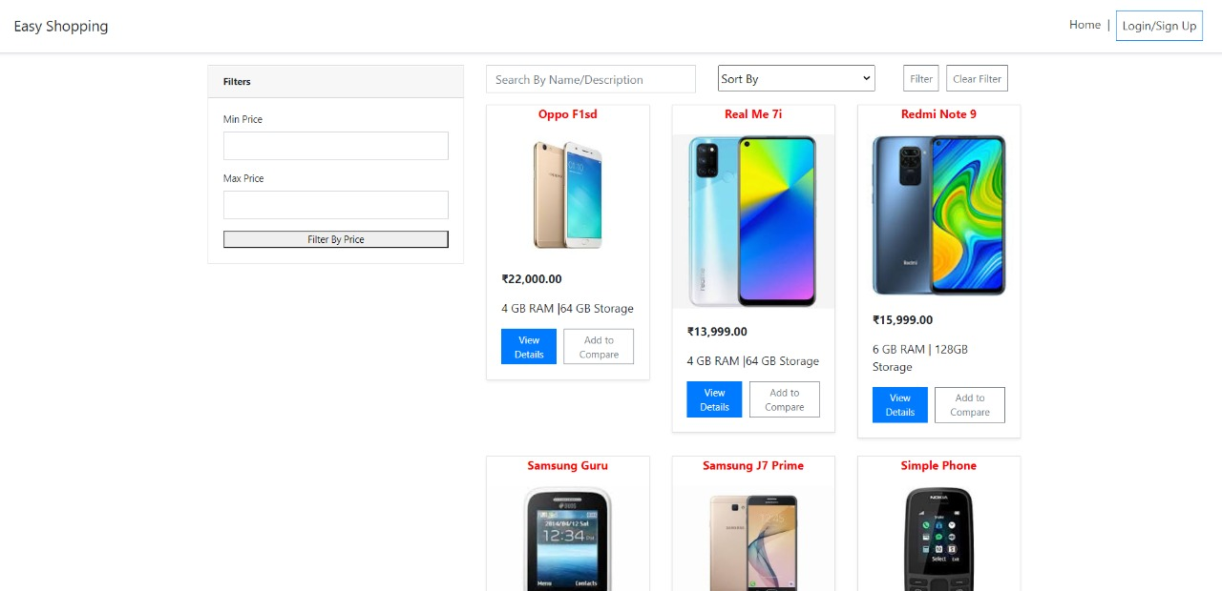
Application View before login

Slide 5
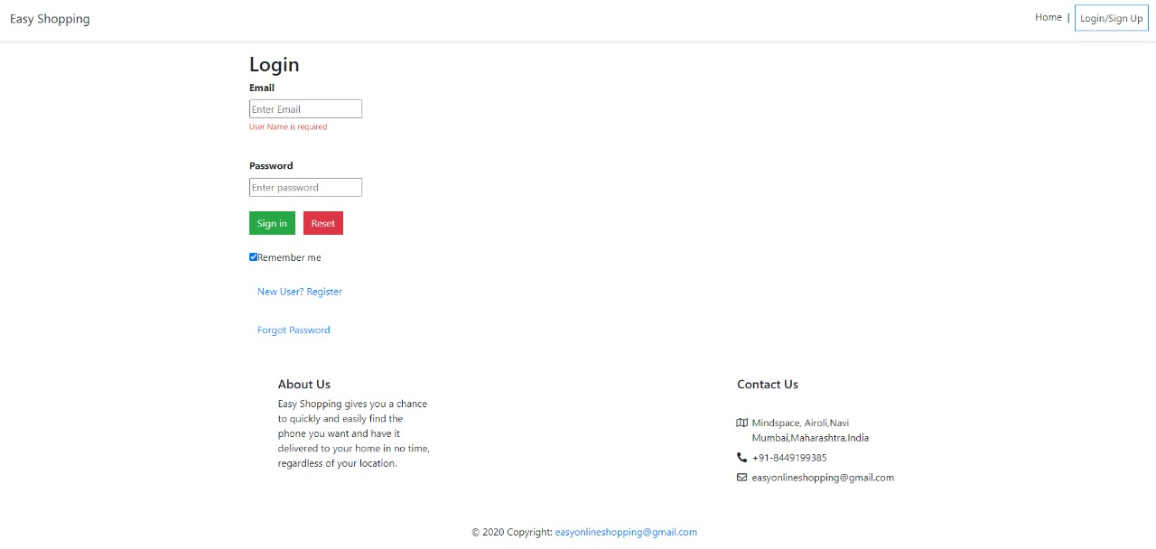
1. User
user login page
New user clicks here for registration
New user clicks here for registration
New user clicks here for registration
If registered user forgot password
If registered user forgot password
If registered user forgot password

Slide 6
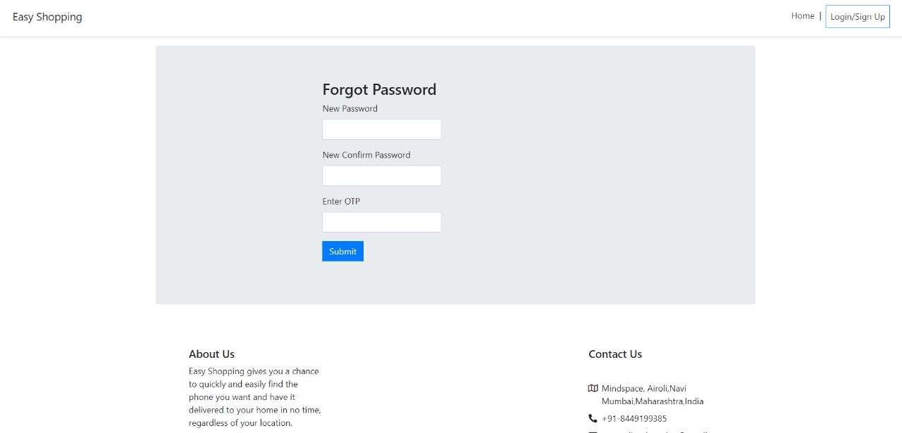
Forgot password page

Slide 7
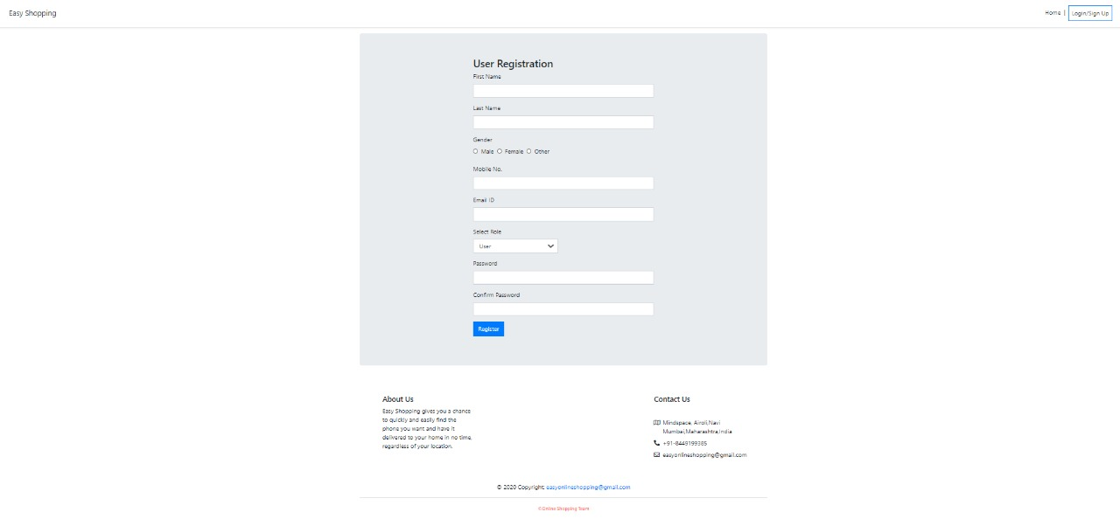
User Registration

Slide 8
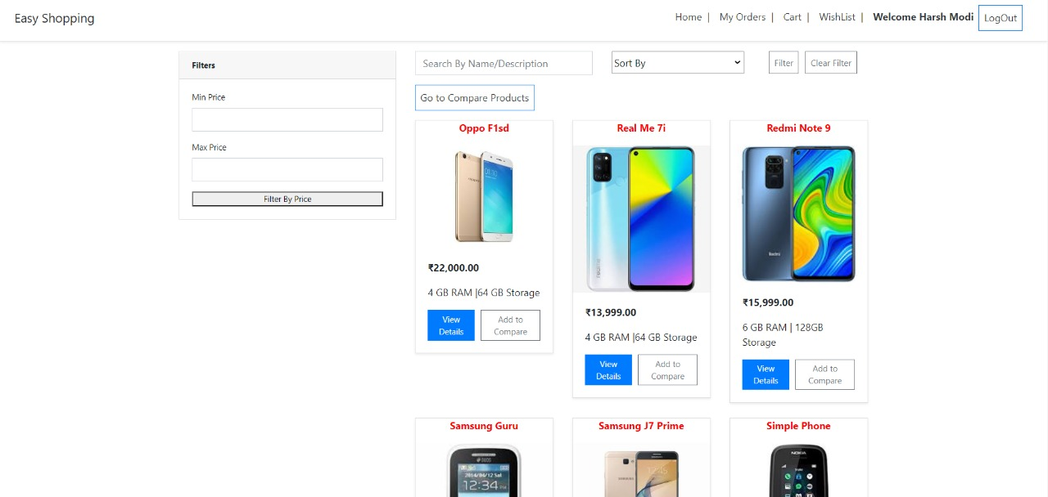
Home page after login

Slide 9
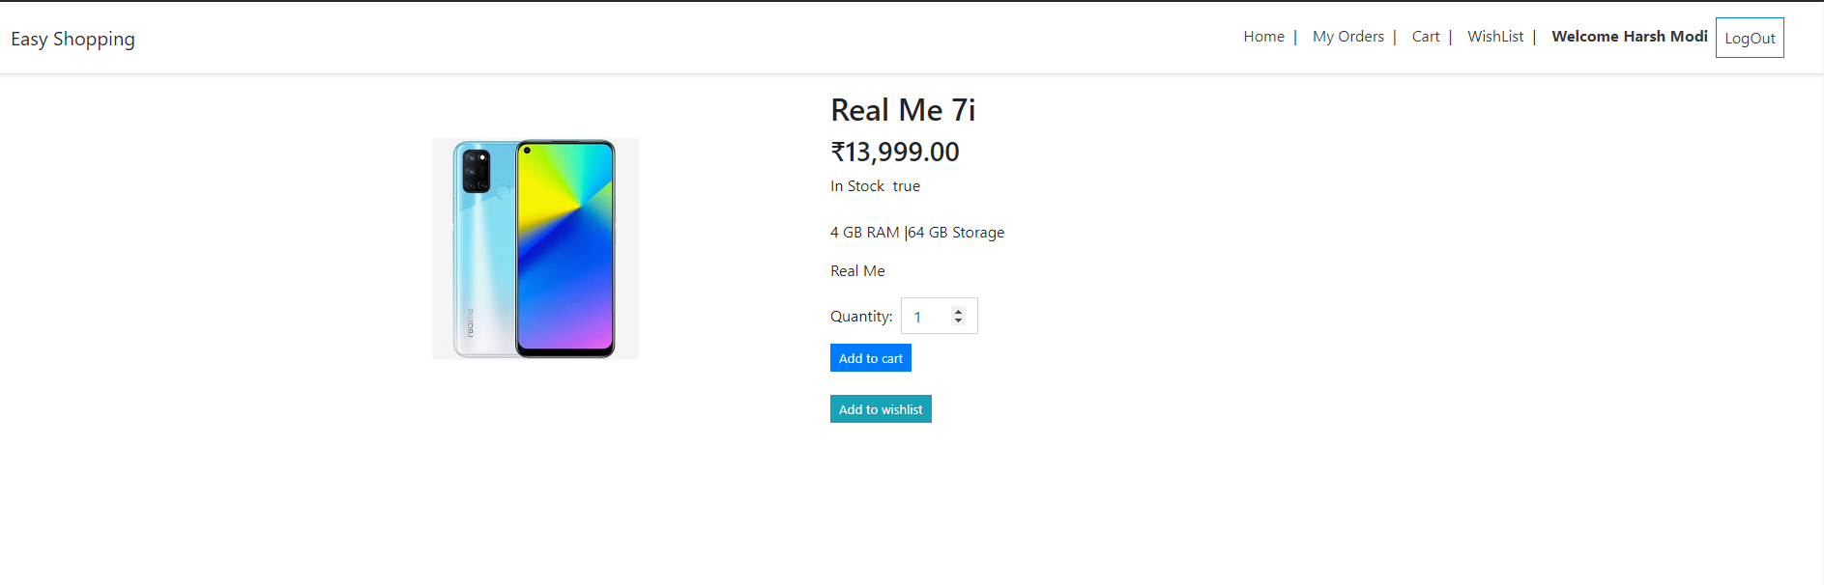
Product description page
Users can add products to cart/wish list here
Users can add products to cart/wish list here
User can add this product to compare with other products

Slide 10
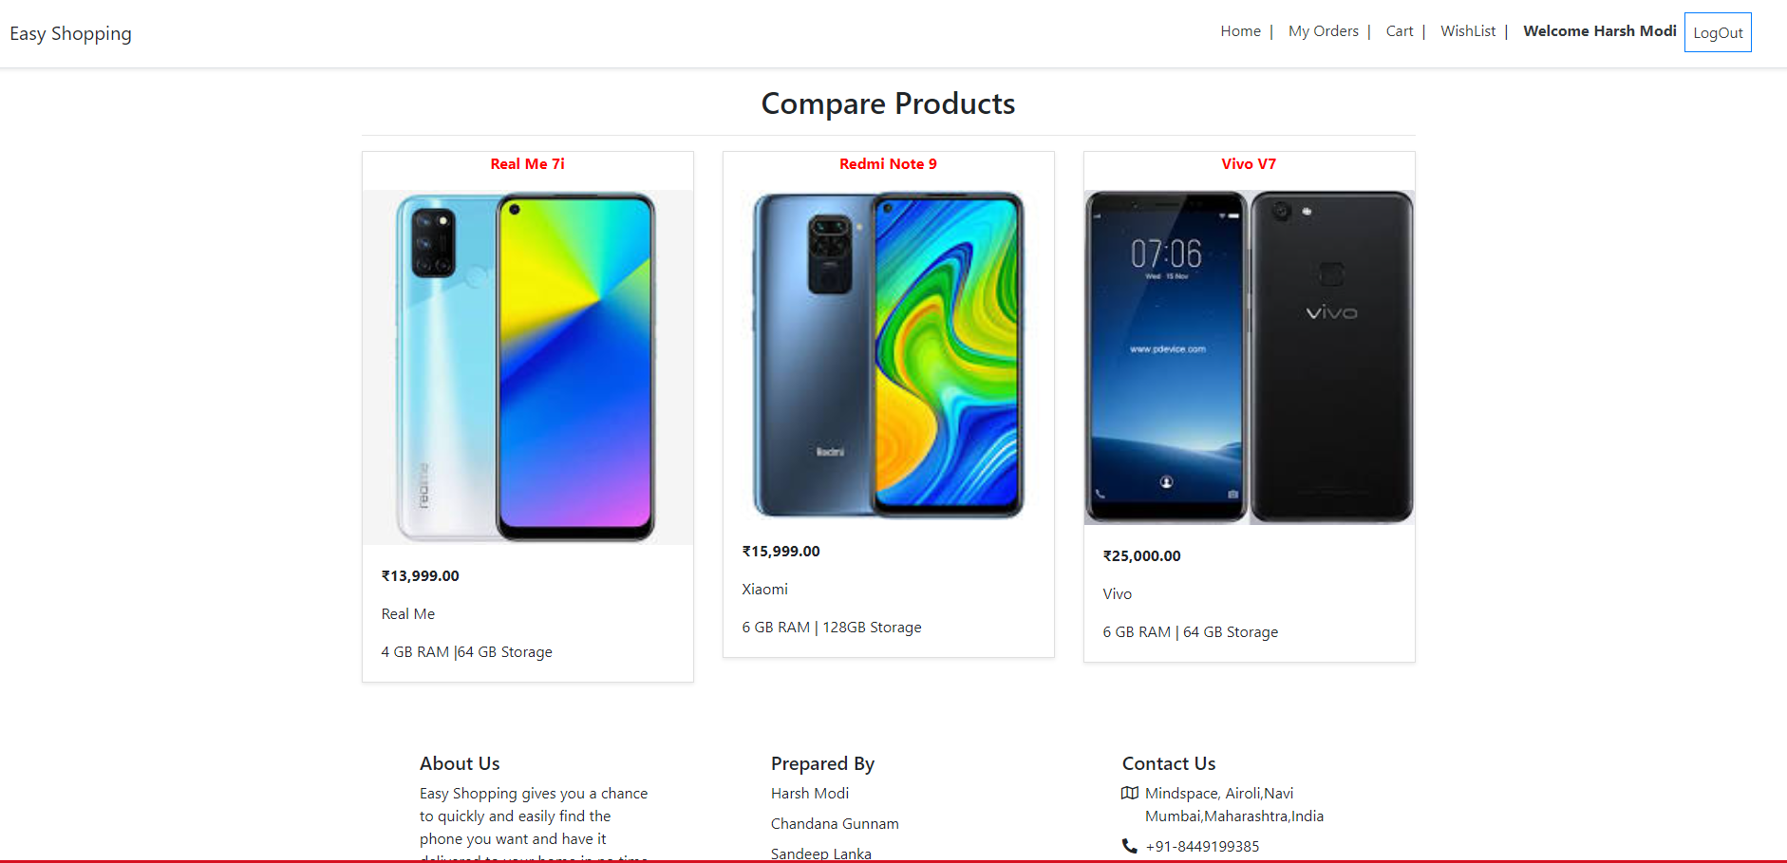
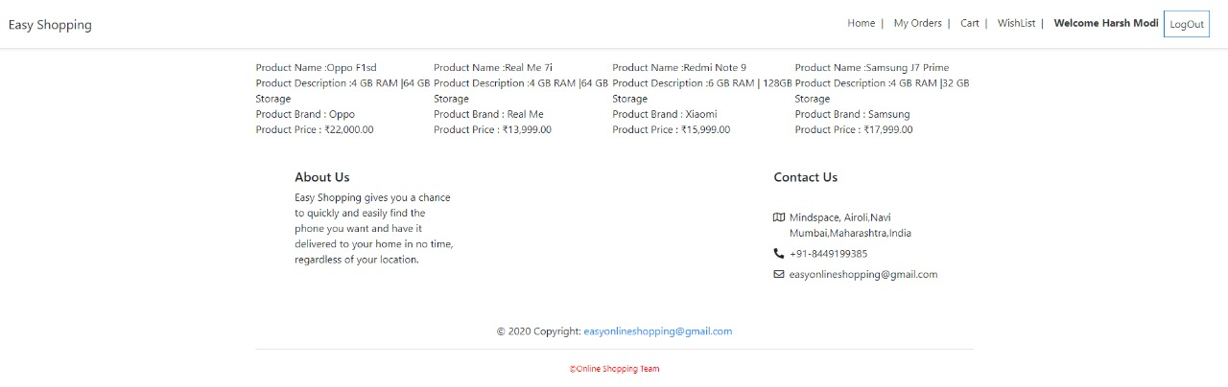
Comparing features of products(up to 4 products)

Slide 11
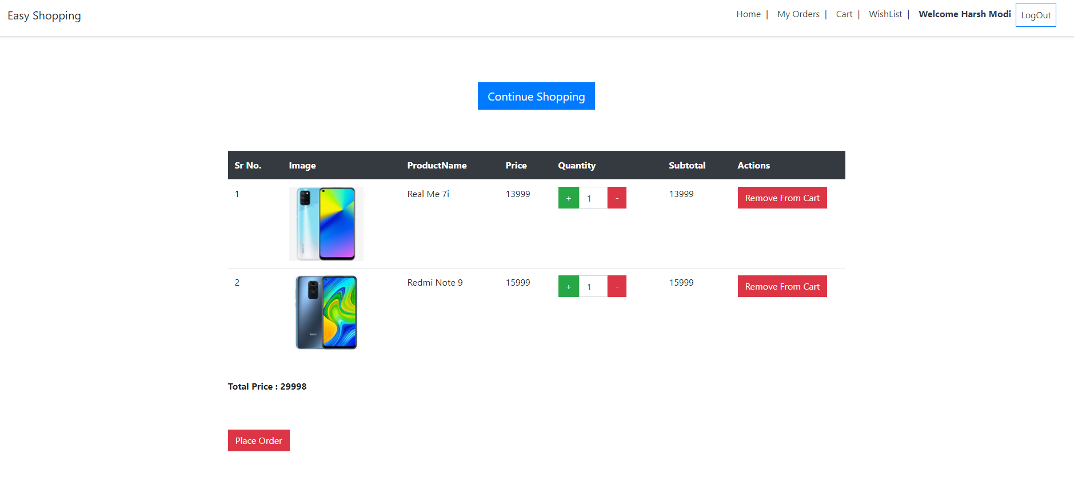
Cart Page
User can change quantity of products here

Slide 12
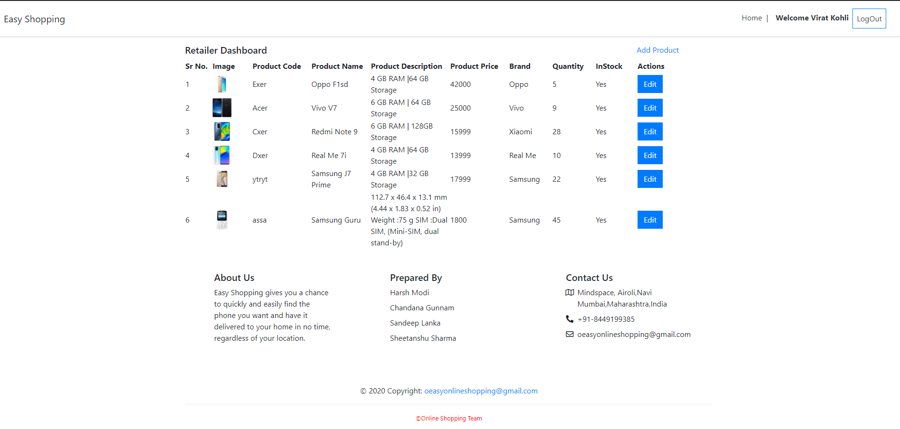
2. Retailer Profile

Slide 13
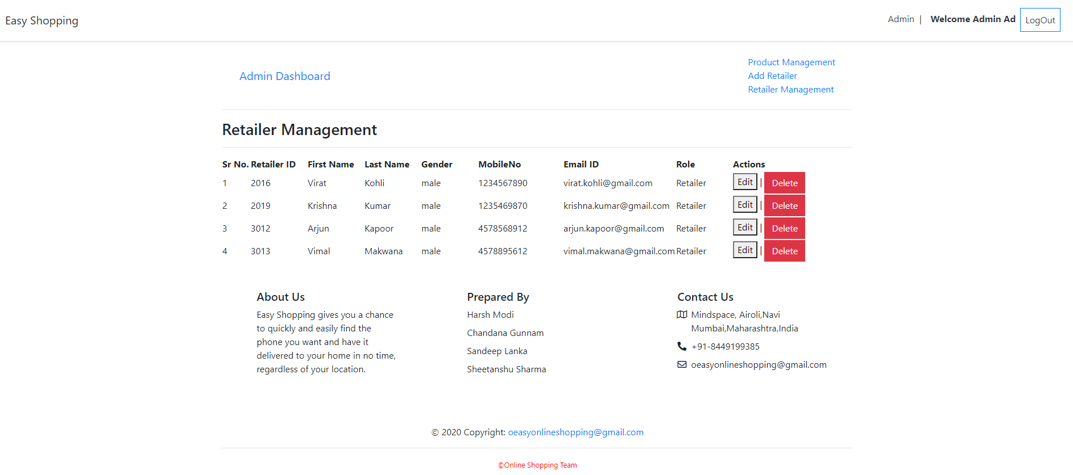
3. Admin Profile

